Slide 1
Digital Business and E-Commerce Management
Lesson 8
Setting a Shopify Site (B2C) Part 2

Slide 2
Setting a Shopify Site (B2C) Part 2
At the end of this lesson, you will be able to
Customize the theme of the E-commerce B2C site (Shopify)
Customize the theme contents and the site pages (Shopify)
Manage menus, links and pages

Slide 3
Activity 8.1
Refer to your book for Activity 8.1

Slide 4
Themes for your Shopify Site
Template that determines the way that your online store looks and feels.
Different themes have different styles and layouts and offer a different experience for your customers.
You can customize the theme of your site by going through the Admin dashboard of your Shopify site

Slide 5
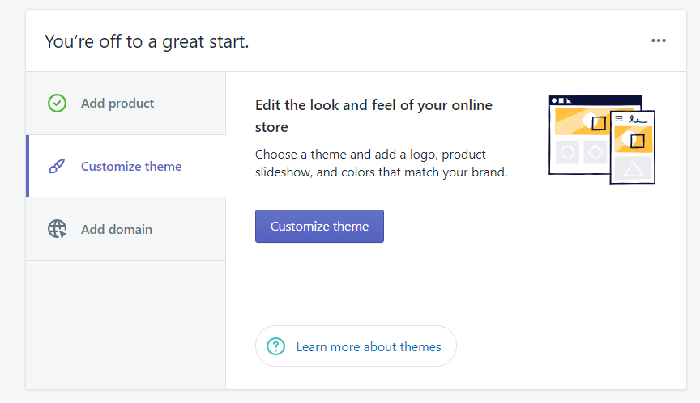
Theme for your Shopify Site 1 – Choosing and Adding Themes
You can choose the themes by clicking on the “Customize Theme” from the Shopify Admin page

Slide 6
Theme for your Shopify Site 1 – Choosing and Adding Themes
You can select and add themes through the following ways:
1. Upload
Upload a custom theme from your computer
Add a theme from the available free teams in the Admin screen
3. Buy and add
Buy and add theme from the Shopify theme store
2. Add

Slide 7
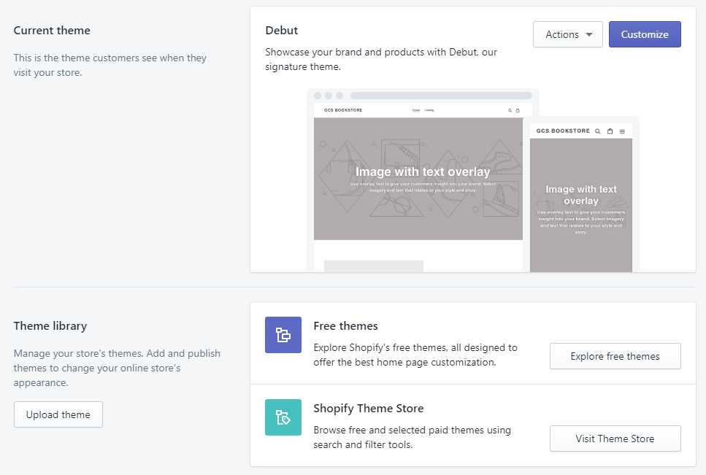
Theme for your Shopify Site 1 – Choosing and Adding Themes
“Debut” is the default theme loaded for a new Shopify site.
But you can easily select and add the themes you like through 3 different ways.
1
2
3

Slide 8
Theme for your Shopify Site 1 – Choosing and Adding Themes
Upload a theme file from your computer
If you have a theme in a .zip file on your computer, you can upload it to the Theme page in the admin screen
Before you upload, make sure that your theme files are compressed into a single .zip file
From your Shopify admin go to Online Store > Themes.
In the Theme library section, click the Upload Theme.
From the Upload theme window, click Choose File to select the .zip file that you wan to upload.
Click Upload. The theme will be added to the Themes page of your admin.

Slide 9
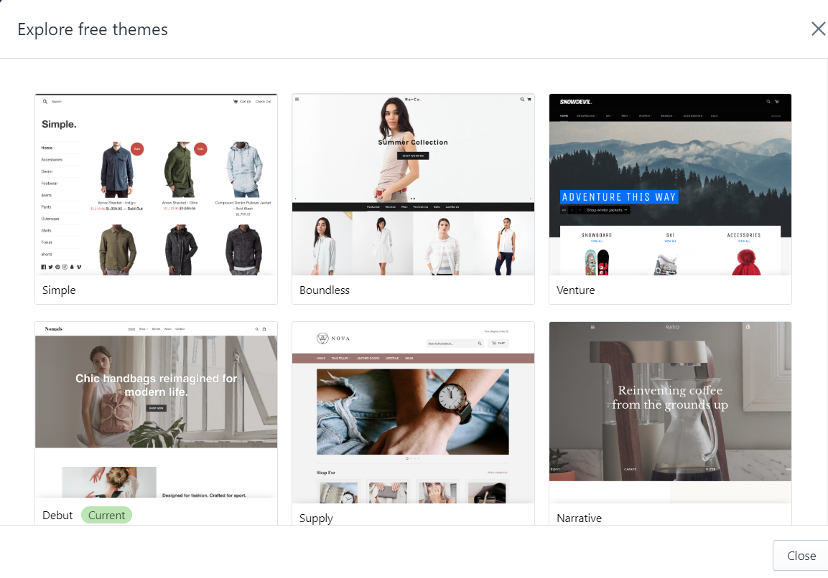
Theme for your Shopify Site 1 – Choosing and Adding Themes
Shopify provides a few free themes which you can choose from.
These themes should be in-line with your design goals or match with the products/services you are offering in your Shopify site.

Slide 10
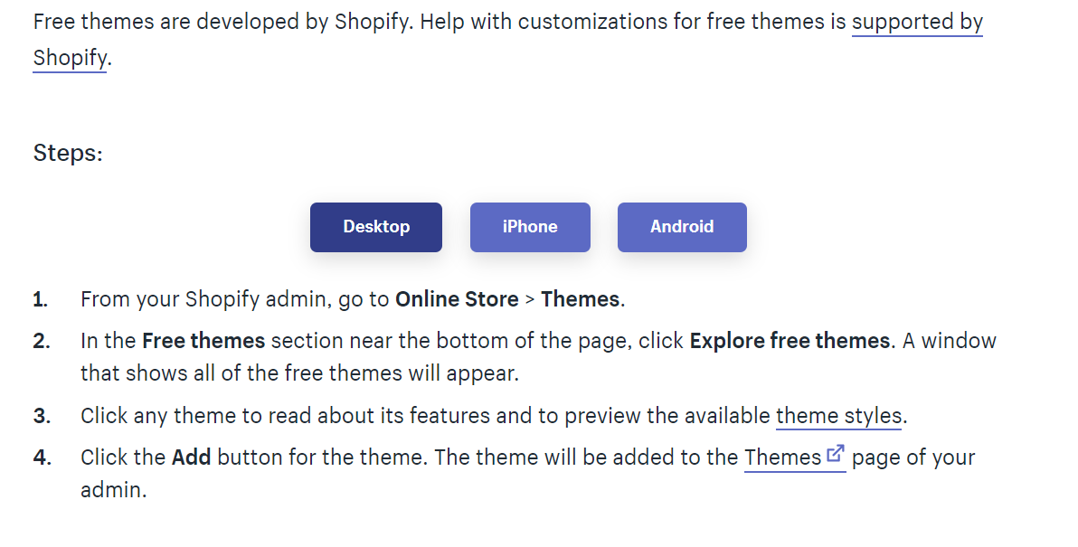
Theme for your Shopify Site 1 – Choosing and Adding Themes
For a video tutorial on adding a free theme refer to the given link: https://youtu.be/aJZZPRBaWZQ

Slide 11
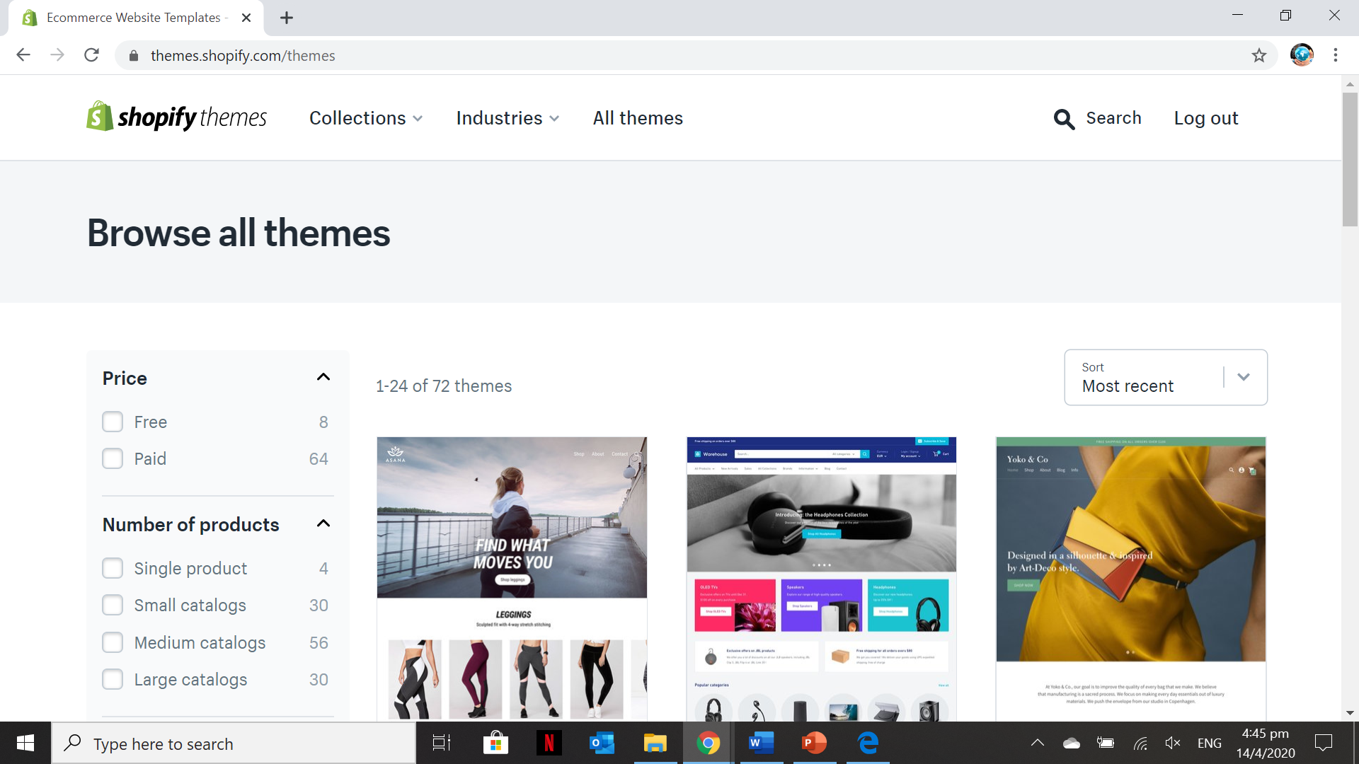
Theme for your Shopify Site 1 – Choosing and Adding Themes
The themes from the themes.shopify.com/themes requires you to purchase it in order to be applied on your Shopify site

Slide 12
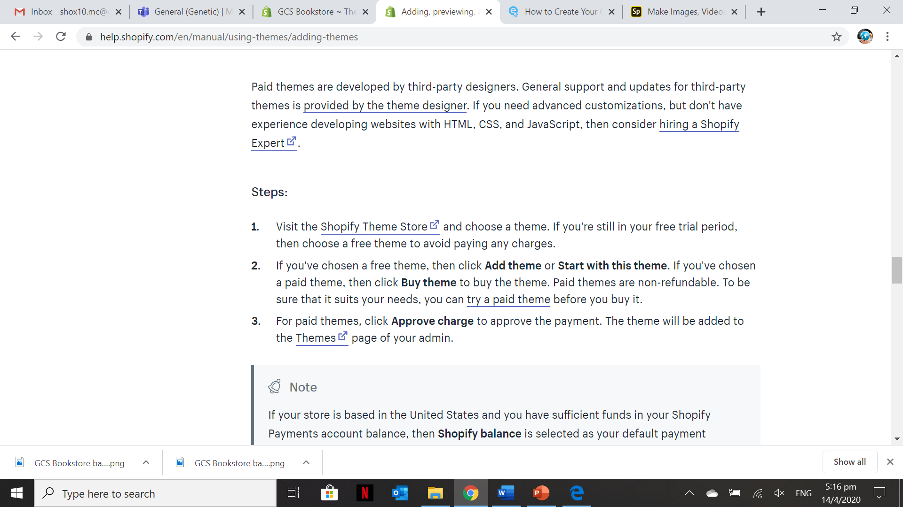
Theme for your Shopify Site 1 – Choosing and Adding Themes
For a video tutorial on adding a paid theme refer to the given link: https://youtu.be/bzFWbsm2ZU4

Slide 13
Activity 8.2
Refer to your book for Activity 8.2

Slide 14
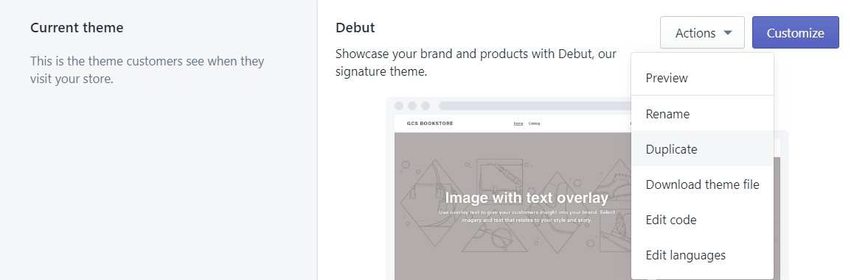
Theme for your Shopify Site 2 – Customizing the Added Theme
It is advisable that before customizing your theme, you either duplicate your current theme or download the theme file for back-up purposes. So, in the event that there are errors and/or wrongly edited you can easily revert it back to the original theme before customization.

Slide 15
Theme for your Shopify Site 2 – Customizing the Added Theme
To edit and customize the theme settings, click on the “Customize” button. This will allow you edit theme sections, theme settings, home page, password page, product pages, collection pages, collection list, Cart and the error page (404 page)

Slide 16
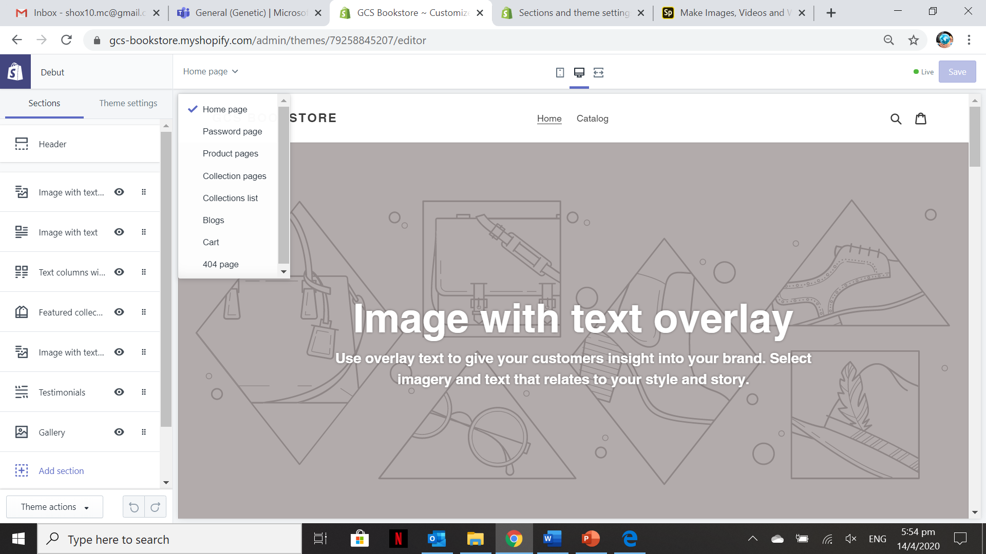
Theme for your Shopify Site 2 – Customizing the Added Theme
In the customize theme admin page, you can edit all the pages in the Shopify site.
Just need to select the page and the go to the section and/or theme setting to customize each element of the page.

Slide 17
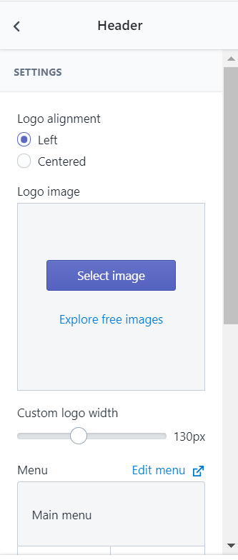
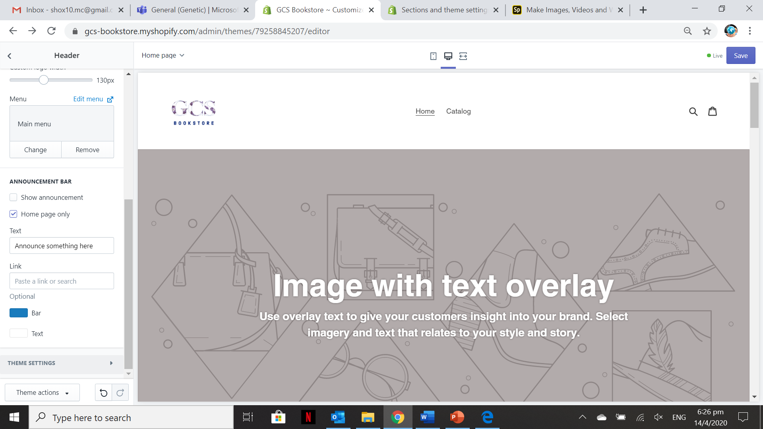
Theme for your Shopify Site 2 – Customizing the Added Theme (Header Section- Logo and other elements)
You can click the “Select Image” button
to upload a logo image.
If you don’t want to display the logo in the “Main Menu”, you can opt to remove.
If you want to show an announcement bar with a corresponding text then just tick the “Show Announcement” checkbox. You can customize the color and the text announcement

Slide 18
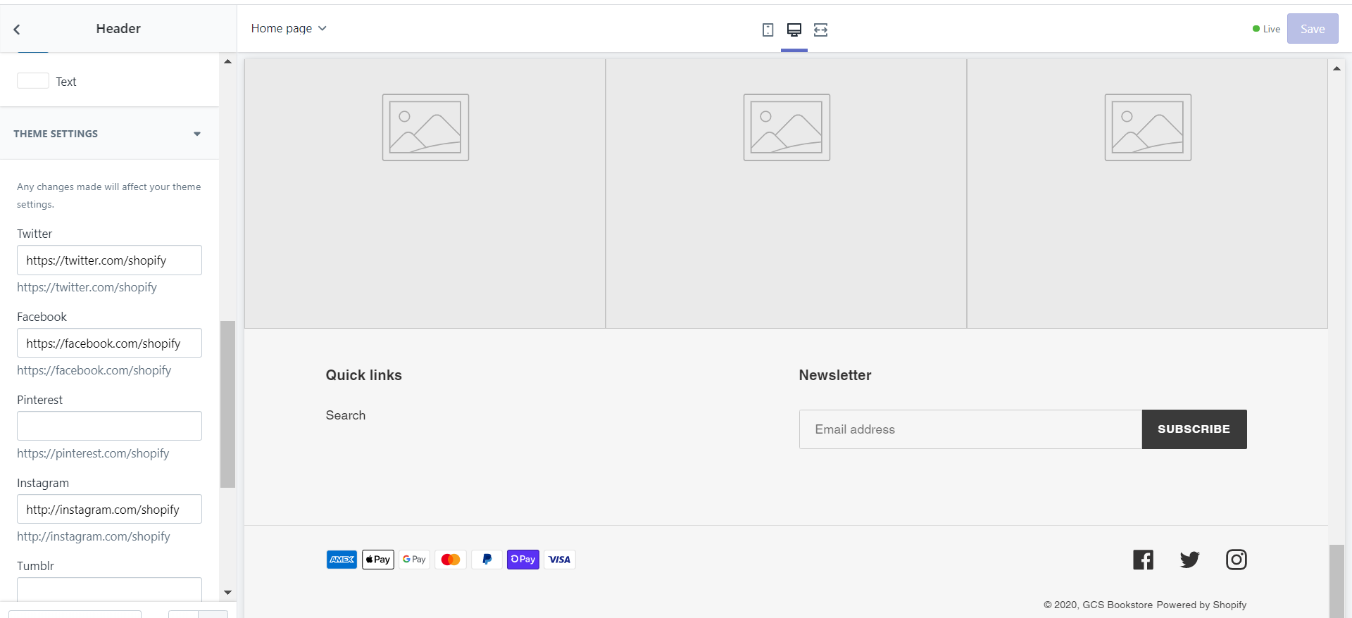
Theme for your Shopify Site 2 – Customizing the Added Theme (Header Section- Logo and other elements)
You can add the social media accounts link from the theme settings of “Header” and this will be displayed below the home page together with the footer

Slide 19
Activity 8.3
Refer to your book for Activity 8.3

Slide 20
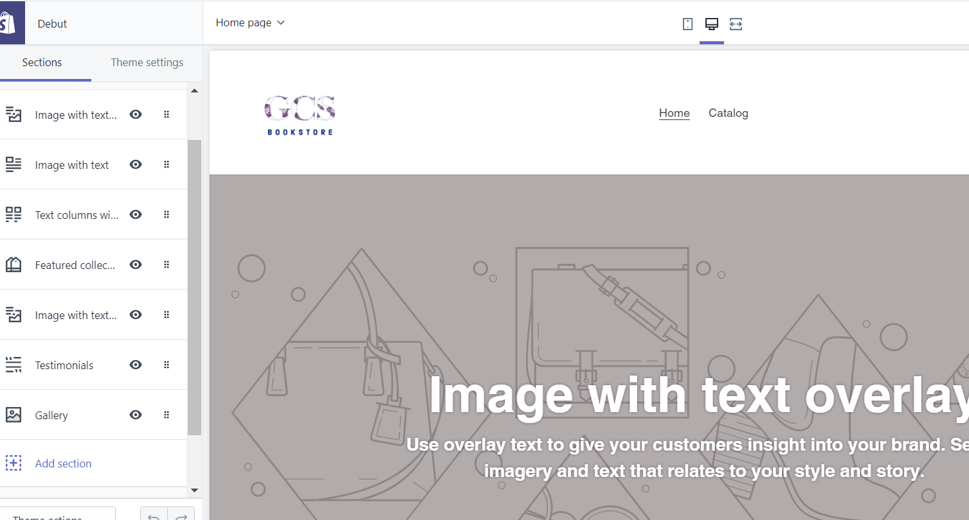
Theme for your Shopify Site 2 – Customizing the Added Theme (Home Page – Banner, Blogs, Featured Collections, Gallery & etc.)
This is the section where you can customize each of the contents in the HOME page of your Shopify site.
You can opt to make the section visible or not visible or you can even add another section
Make sure to SAVE any changes to automatically reflect it in your Shopify site Home Page

Slide 21
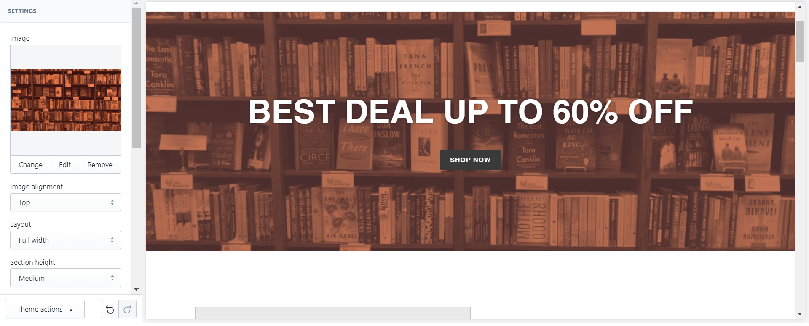
Theme for your Shopify Site 2 – Customizing the Added Theme (Home Page – Banner, Blogs, Featured Collections, Gallery & etc.)
Customization on the “Image with text overlay” which serves as the banner in the Shopify Site.

Slide 22
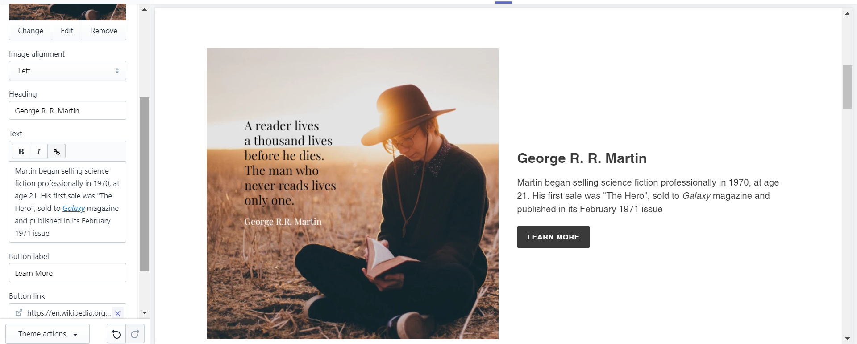
Theme for your Shopify Site 2 – Customizing the Added Theme (Home Page – Banner, Blogs, Featured Collections, Gallery & etc.)
In this section you can customize which product to feature or a blog to feature. You can have a button to direct it into the details of the featured product, collection and/or blog.

Slide 23
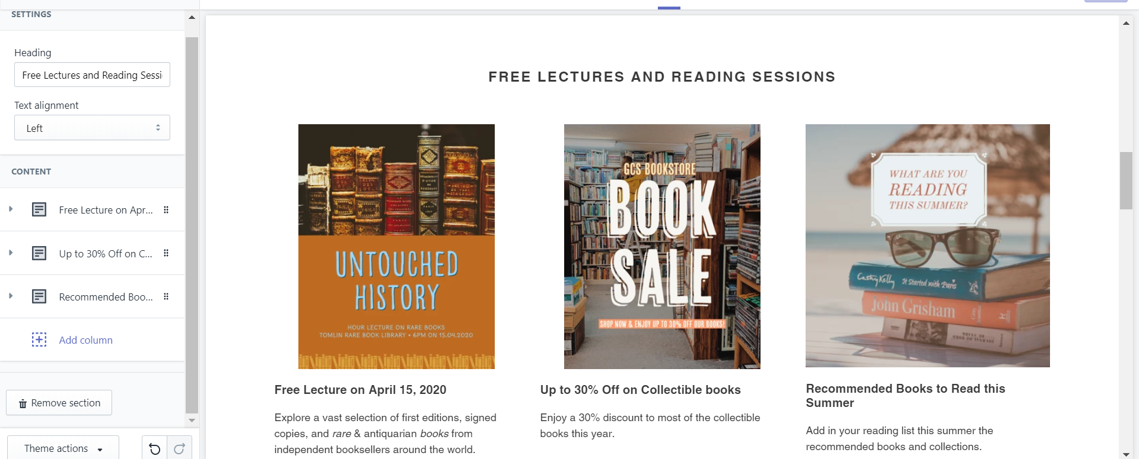
Theme for your Shopify Site 2 – Customizing the Added Theme (Home Page – Banner, Blogs, Featured Collections, Gallery & etc.)
In this section you can add 3 or more columns with different marketing or promotional contents and/or activities. You can also add button to direct to your products, blogs or collections.

Slide 24
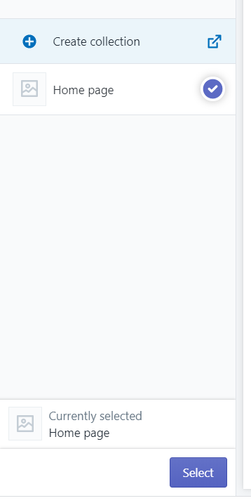
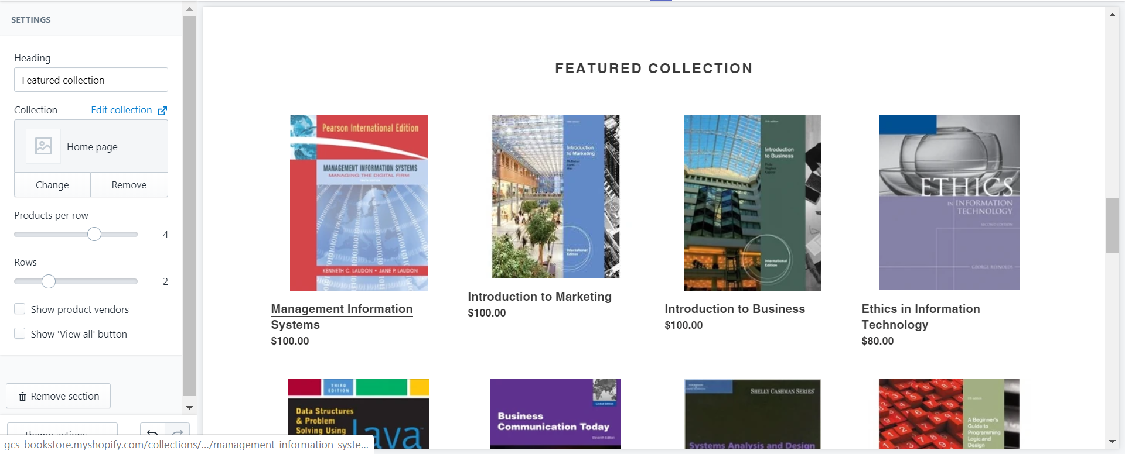
Theme for your Shopify Site 2 – Customizing the Added Theme (Home Page – Banner, Blogs, Featured Collections, Gallery & etc.)
In this section you can customize the featured collections. You can also customize how many products per row and how many rows to add. Do take note that the collection is based on the “Collection Name” you selected when you added the products in your Shopify site.

Slide 25
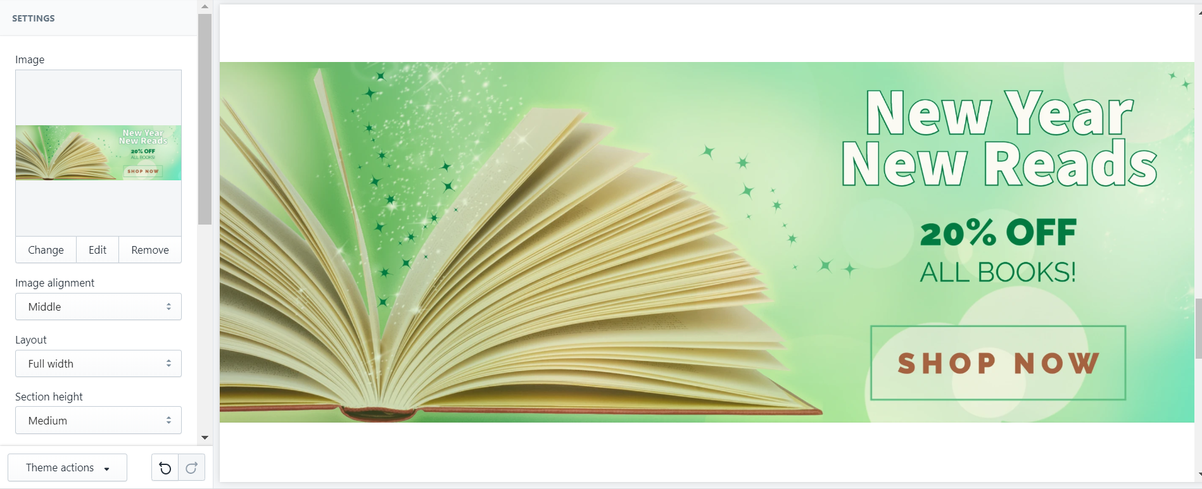
Theme for your Shopify Site 2 – Customizing the Added Theme (Home Page – Banner, Blogs, Featured Collections, Gallery & etc.)
This section allows you to customize additional promotional/advertisement content on the Home Page of your Shopify site. You can opt to make it visible or not visible. Remember that this content is based on the Theme used.

Slide 26
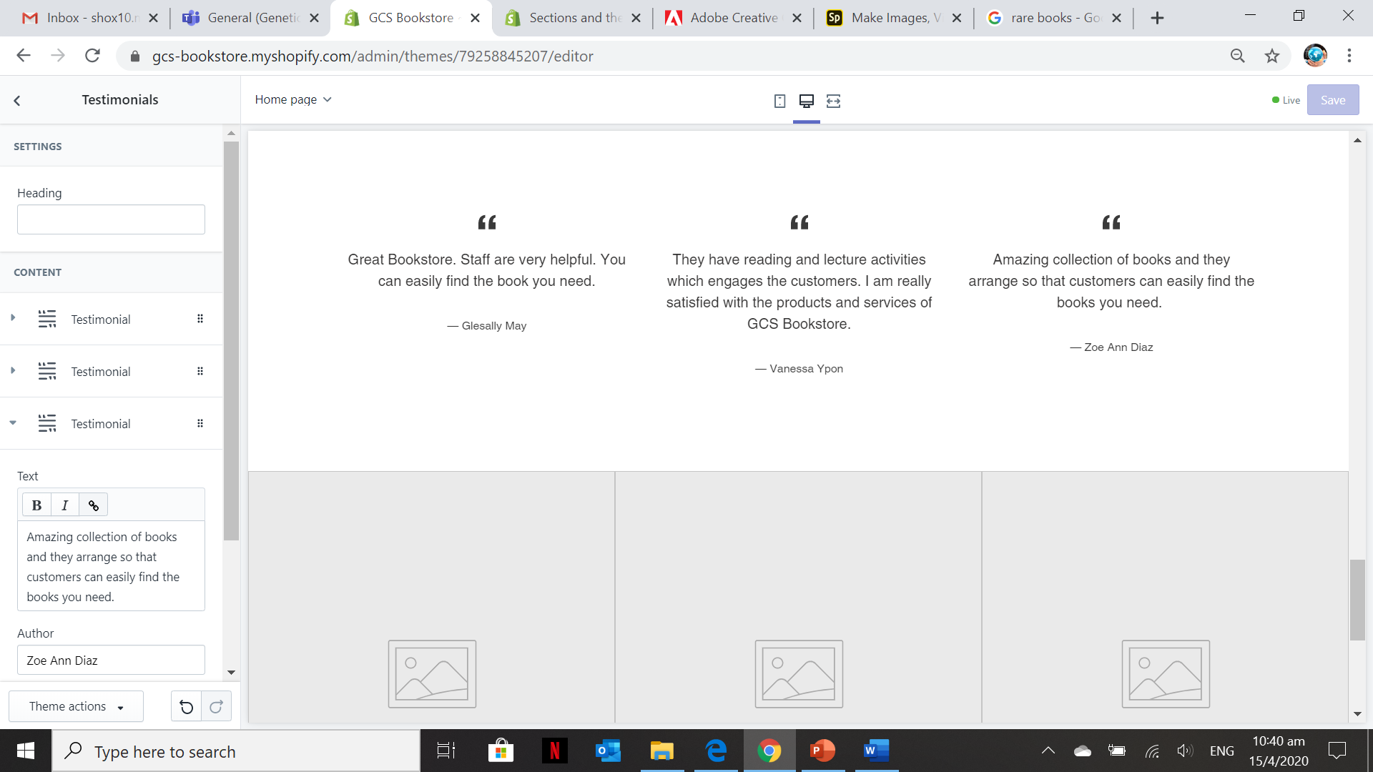
Theme for your Shopify Site 2 – Customizing the Added Theme (Home Page – Banner, Blogs, Featured Collections, Gallery & etc.)
This section allows you to add testimonials from the customers. The testimonials is for branding purposes, adds credibility on the products/services offered by the company

Slide 27
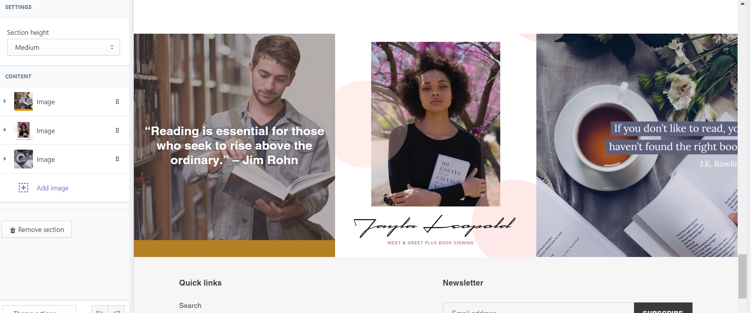
Theme for your Shopify Site 2 – Customizing the Added Theme (Home Page – Banner, Blogs, Featured Collections, Gallery & etc.)
This section allows you to add a gallery of images. This images could be a series of activities/promotional campaigns/facilities & etc. of the company. You can add caption or a link to direct it to a product and/or blog feature.

Slide 28
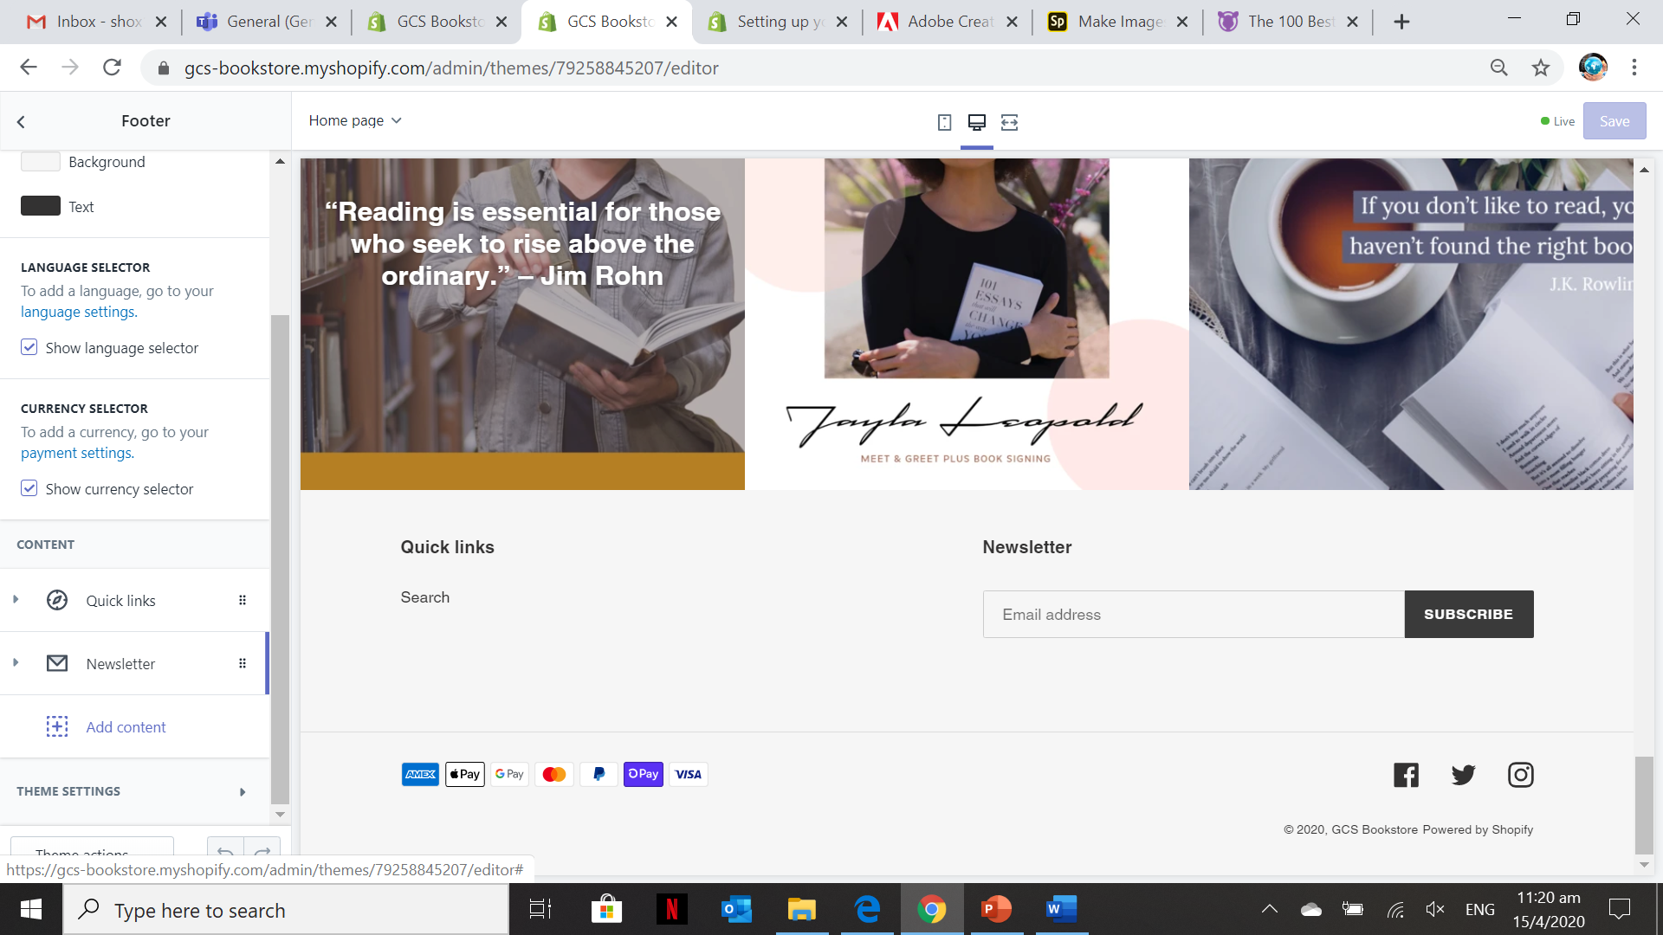
Theme for your Shopify Site 2 – Customizing the Added Theme (Home Page – Banner, Blogs, Featured Collections, Gallery & etc.)
In the footer section, you can have language selector, currency selector, quick links, newsletter or you can add a customized content not part of the theme. Just need to click “Add content” to add additional content on the footer.

Slide 29
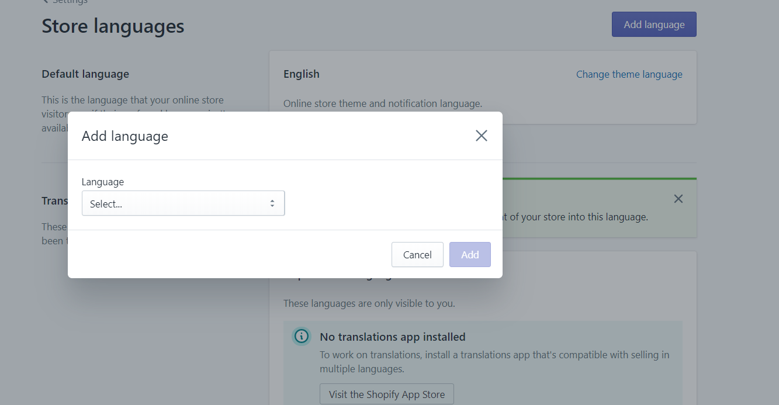
Theme for your Shopify Site 2 – Customizing the Added Theme (Home Page – Banner, Blogs, Featured Collections, Gallery & etc.)
Click on “Add the Language”
Select the preferred language

Slide 30
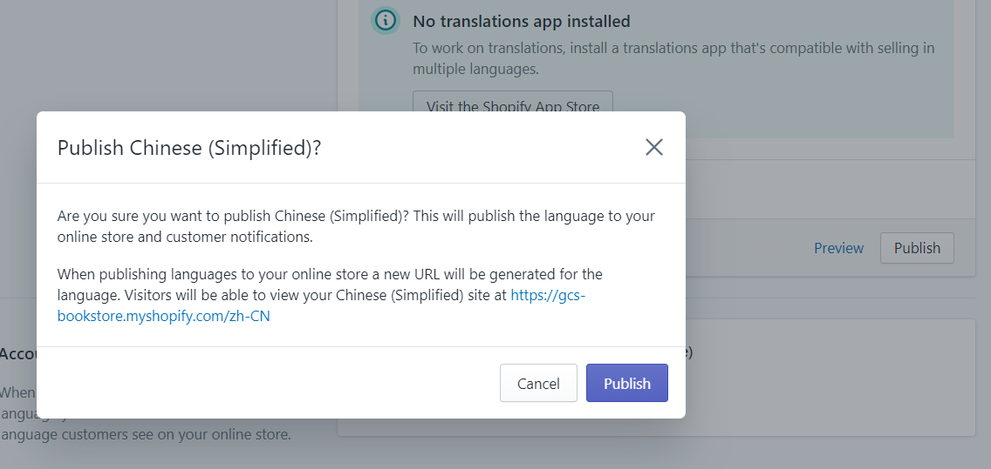
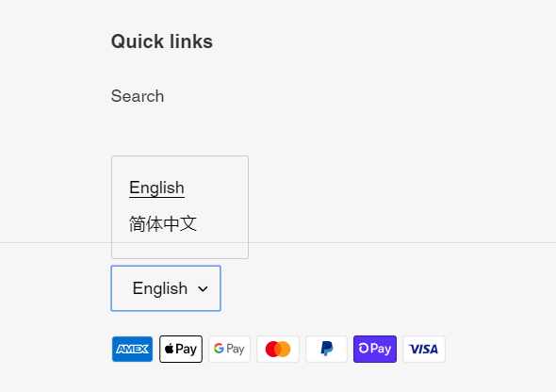
Theme for your Shopify Site 2 – Customizing the Added Theme (Home Page – Banner, Blogs, Featured Collections, Gallery & etc.)
If you added a new language a new site URL will be generated and users can access it via the link provided

Slide 31
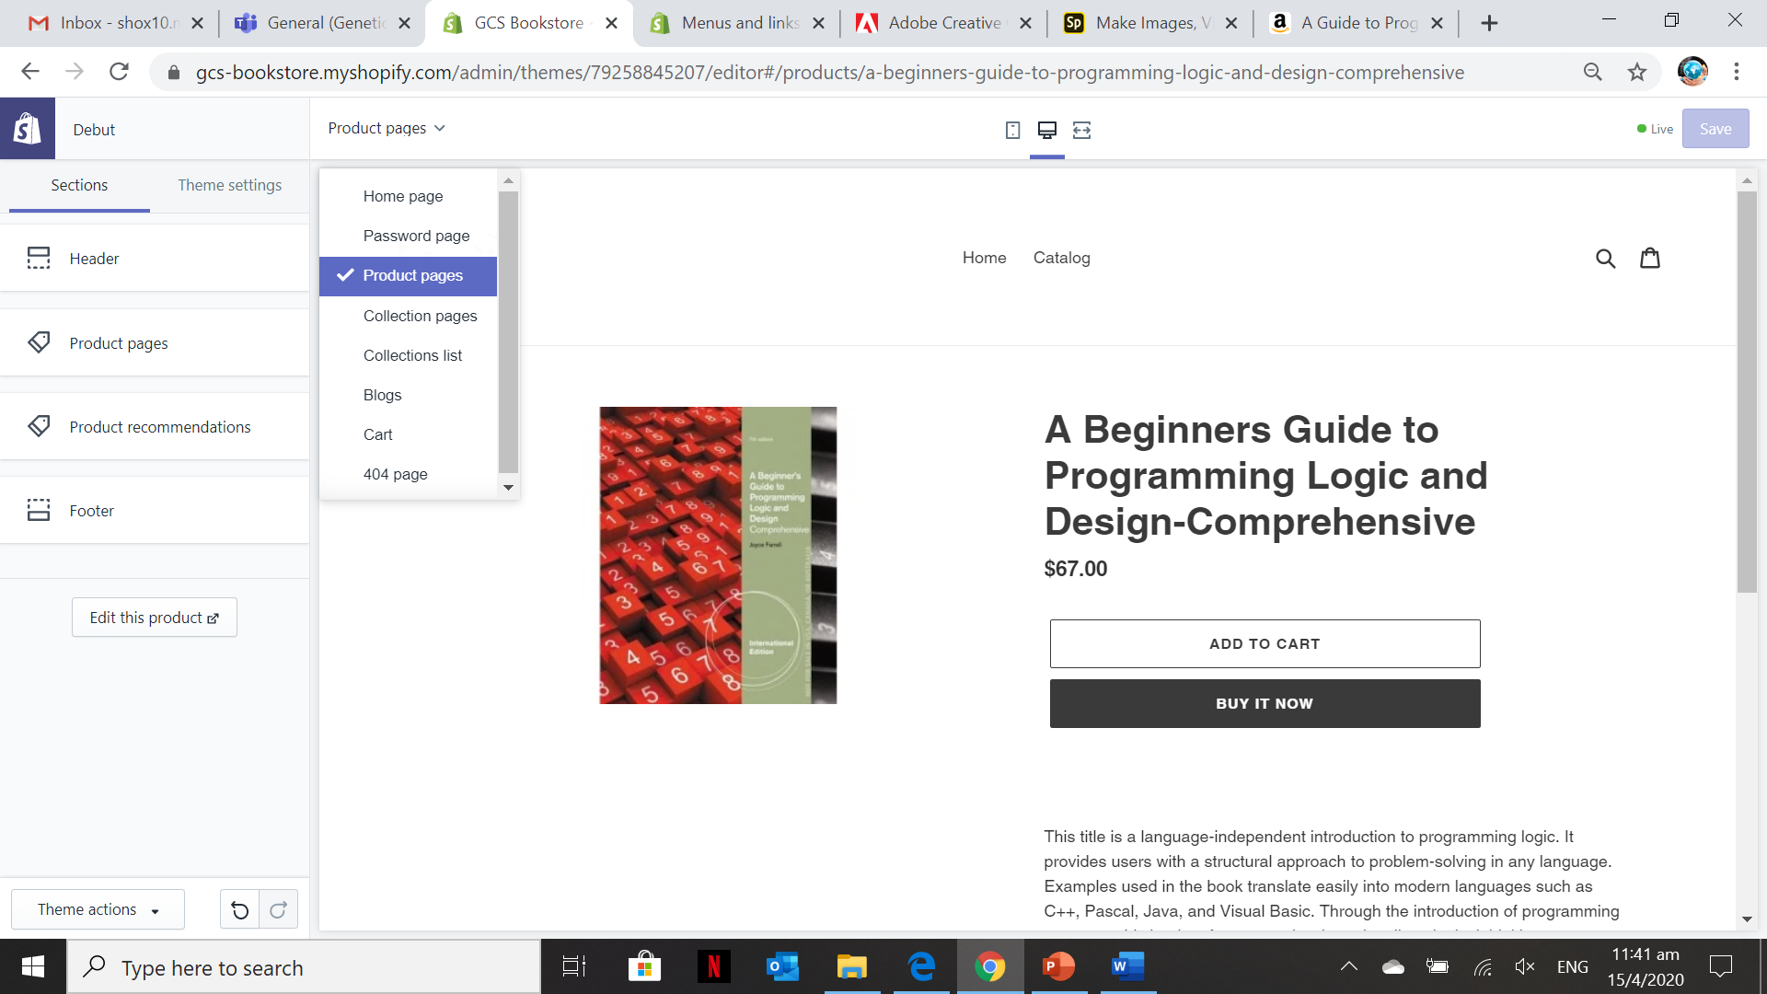
Theme for your Shopify Site 2 – Customizing the Added Theme (Product Page)
Select it from the “Product Page” from the dropdown menu
You can customize the header, product pages contents and product recommendation in this section.

Slide 32
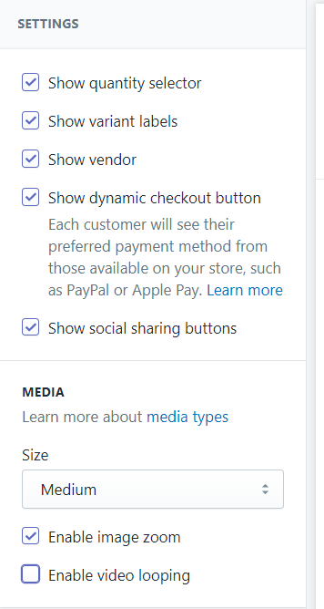
Theme for your Shopify Site 2 – Customizing the Added Theme (Product Page)
If you want to show all the contents of the product pages, you can just tick all the checkboxes and those elements will be displayed on the Product page.

Slide 33
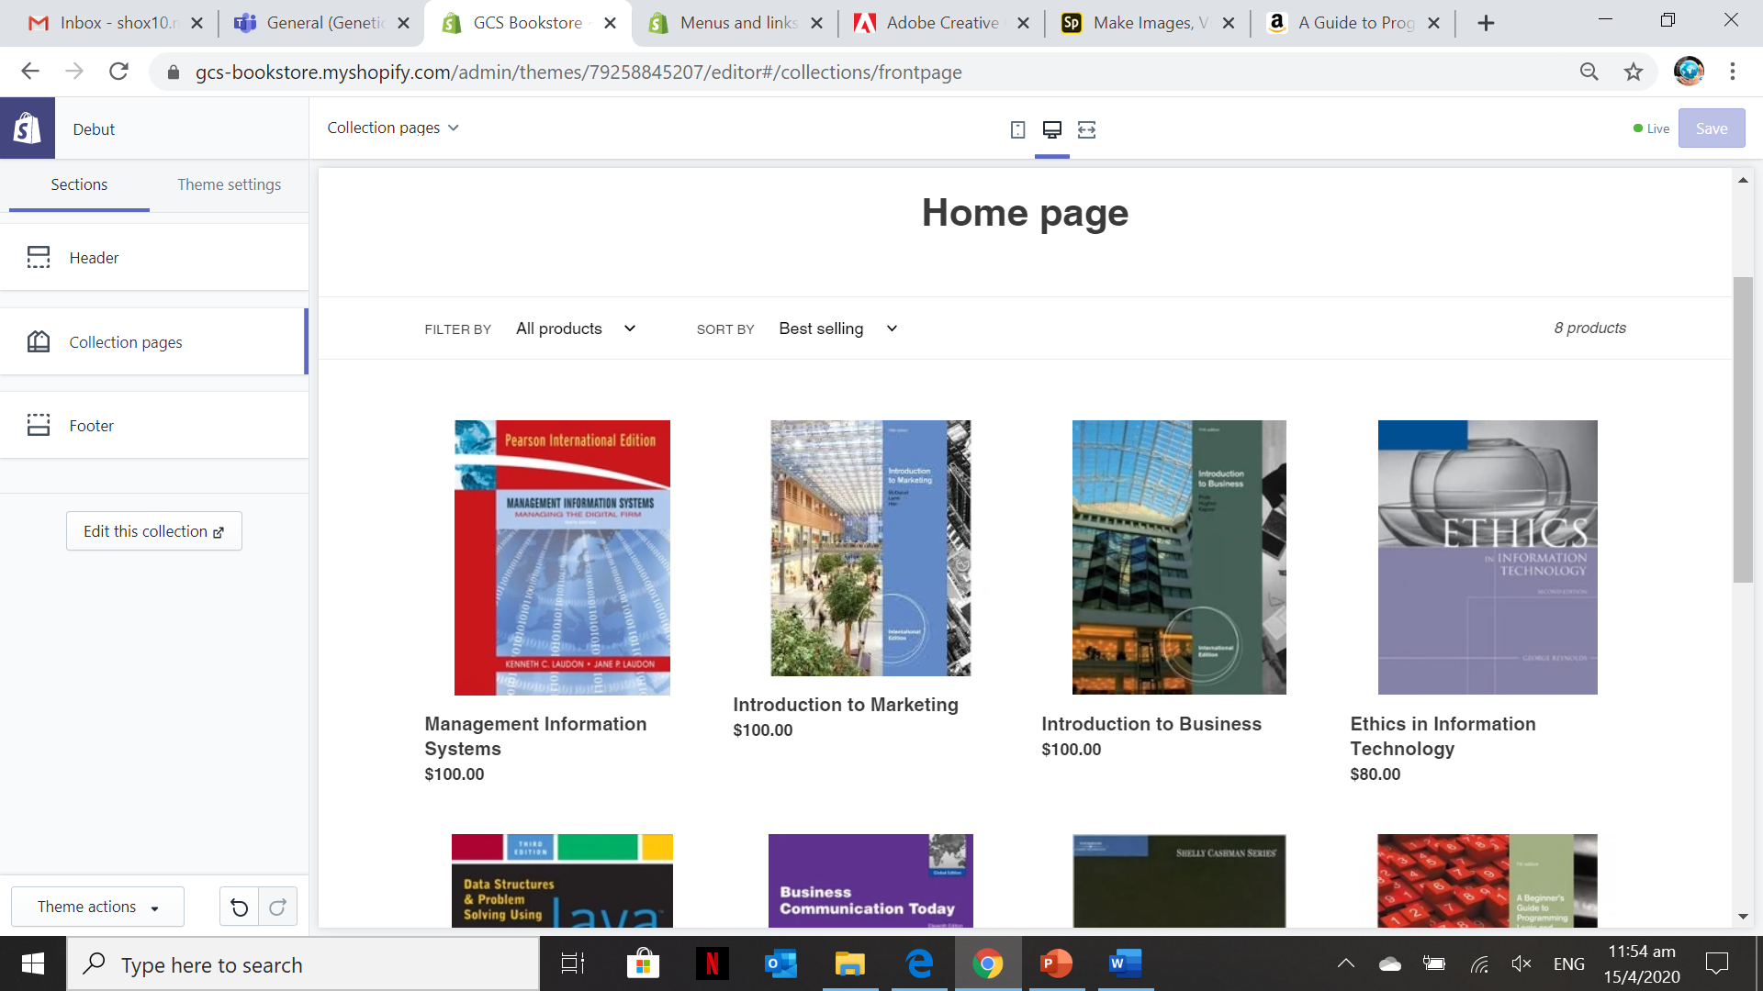
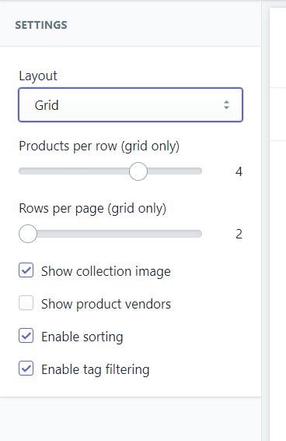
Theme for your Shopify Site 2 – Customizing the Added Theme (Collection Page)
You can customize the Layout of the collection into a “Grid” or a “List”.
You can also customize the number of products per row or the number of rows.
Additional settings like product vendor, sorting and filtering is also available.

Slide 34
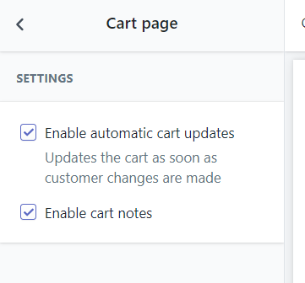
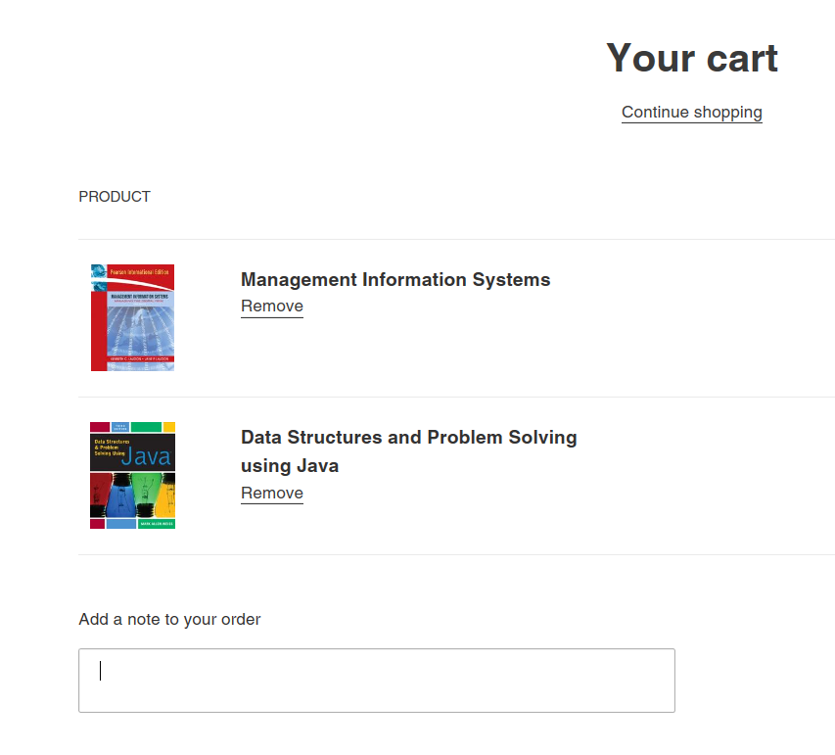
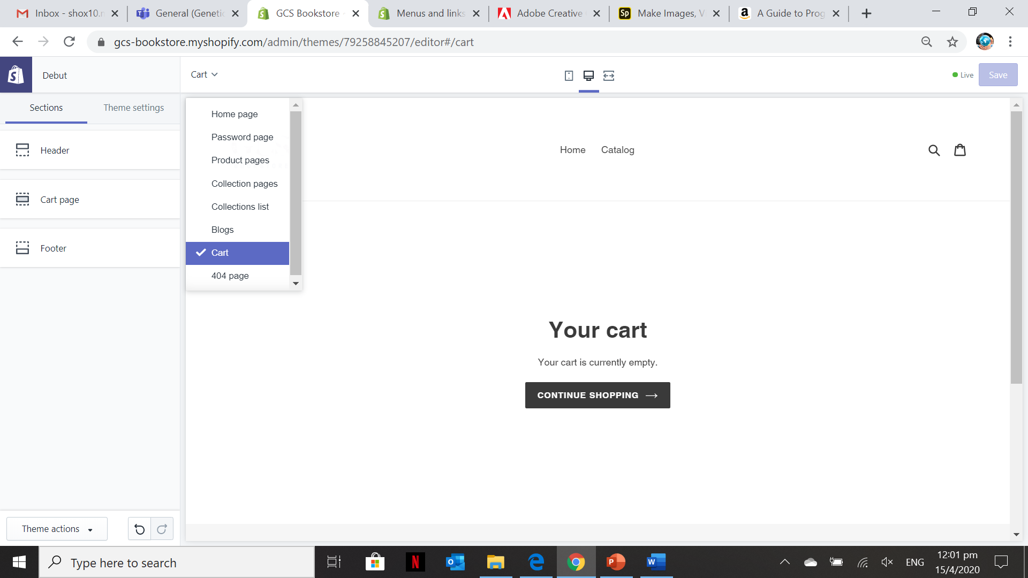
Theme for your Shopify Site 2 – Customizing the Added Theme (Cart Page)
By default the “Enable automatic cart updates” is tick so that every time you add item into the cart it will pop-up a notification at the rightmost side of the page
If you “Enable cart notes” the customer can add notes to their order on the image above.

Slide 35
Activity 8.4
Refer to your book for Activity 8.4

Slide 36
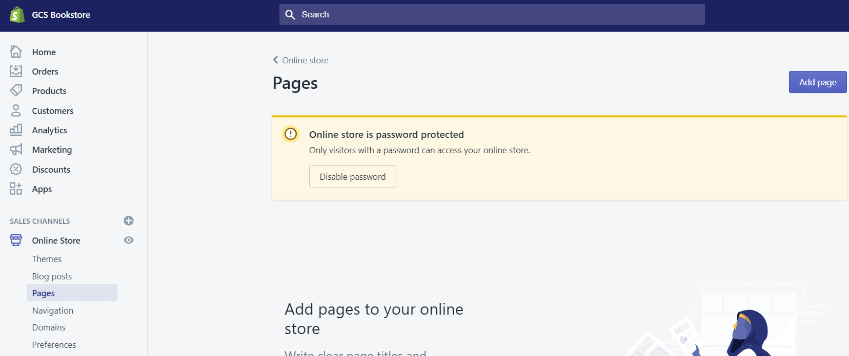
Theme for your Shopify Site 3 – Manage Menus, Links, and Pages (Adding Pages)
Go to Online Store> Pages
This section in the Admin screen allows you to add Pages like “About Us”, “Contact Us” & etc.

Slide 37
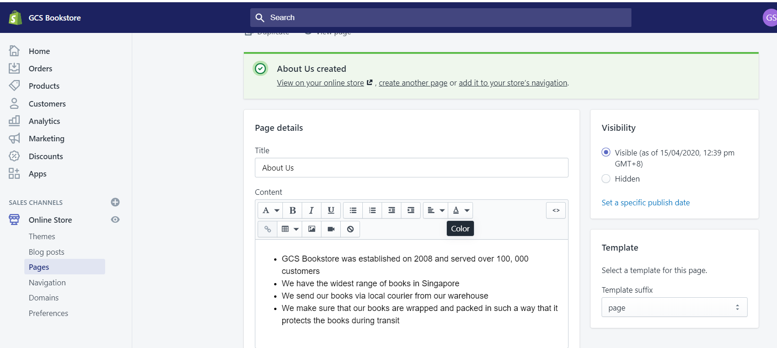
Theme for your Shopify Site 3 – Manage Menus, Links, and Pages (Adding Pages – About Us)
The title contents will serve as the “Title Heading” of the Page and will be part of the URL as https://gcs-bookstore.myshopify.com/pages/about-us

Slide 38
Theme for your Shopify Site 3 – Manage Menus, Links, and Pages (Adding Pages – About Us)
When writing the About Us page, consider the following goals:
Be motivating
Be authentic
Be engaging

Slide 39
Theme for your Shopify Site 3 – Manage Menus, Links, and Pages (Adding Pages – About Us)
Suggested information to be included in the About Us page
What you sell - anything that makes your products different
Why you sell it - your company mission or values
Who you are - your company, your founder, or your producers
Who you're selling to - your approach to customer service or customer satisfaction
Why you're different - specific expertise, customer testimonials, or additional services

Slide 40
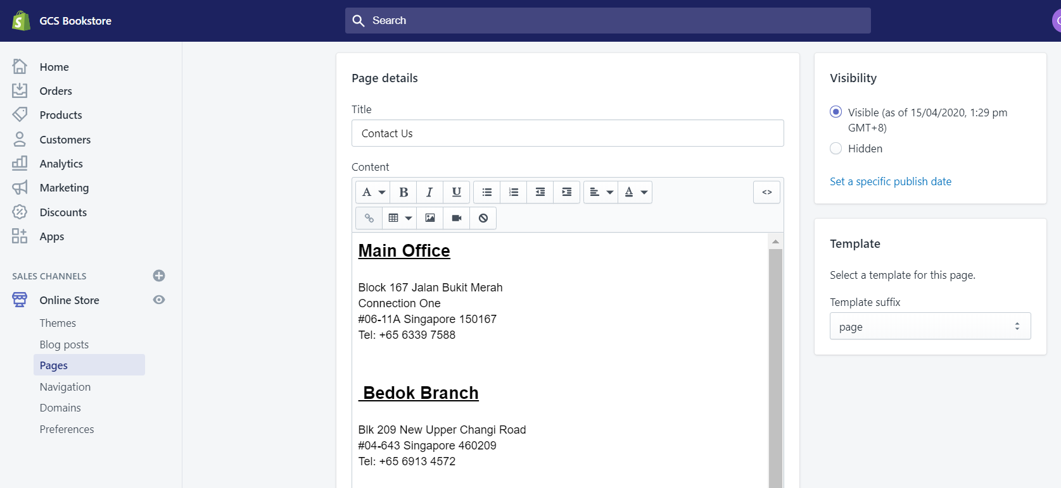
Theme for your Shopify Site 3 – Manage Menus, Links, and Pages (Adding Pages-Contact Us)

Slide 41
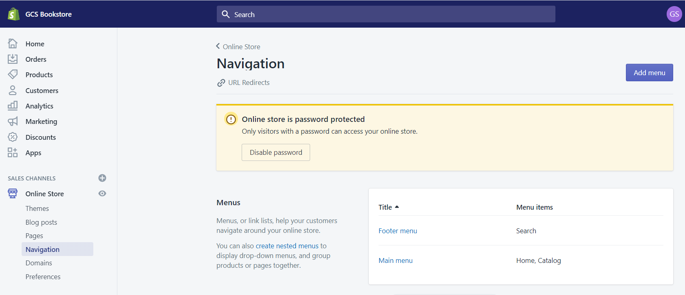
Theme for your Shopify Site 3 – Manage Menus, Links, and Pages (Understanding Navigation)
Your Shopify site has two default menus that appear on every page: the main menu and the footer menu. You can add, remove, or edit menu items in your online store's default menus.

Slide 42
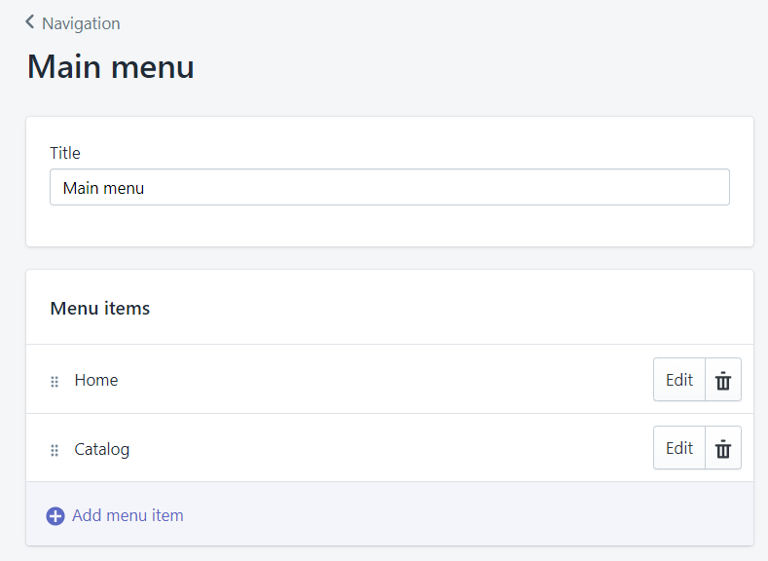
Theme for your Shopify Site 3 – Manage Menus, Links, and Pages (Understanding Navigation – Main Menu)
Your main menu has two default menu items:
Home: the main page of your online store
Catalog: a page that displays all the products
You can add a drop-down menu from any of the menu items in the main menu. A drop-down menu is a sub-menu from the main menu and is usually displayed as a list of items connected to the main menu item.
Note:
You can customize the title of the menu items by clicking on “Edit”

Slide 43
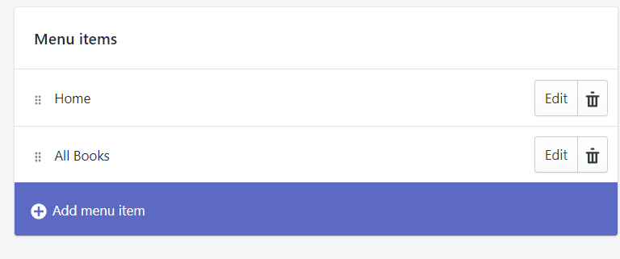
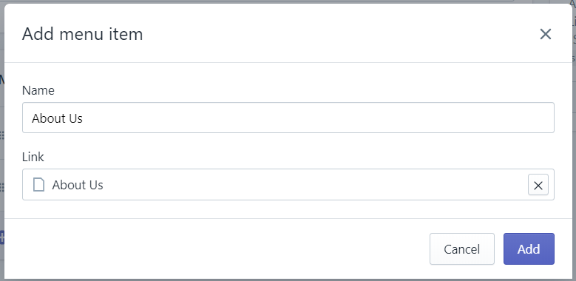
Theme for your Shopify Site 3 – Manage Menus, Links, and Pages (Understanding Navigation – Adding and Editing Menu Items)
You can add menu items to link to:
webpages
collections
products
blogs or blog posts
store policies
external websites
email links
For the Link, you can select it from Pages. In the Example, the Menu is “About Us” so it was link the previously created “About Us” page
For more information on adding and editing menu items watch the video https://youtu.be/xYGuJhKiOZw

Slide 44
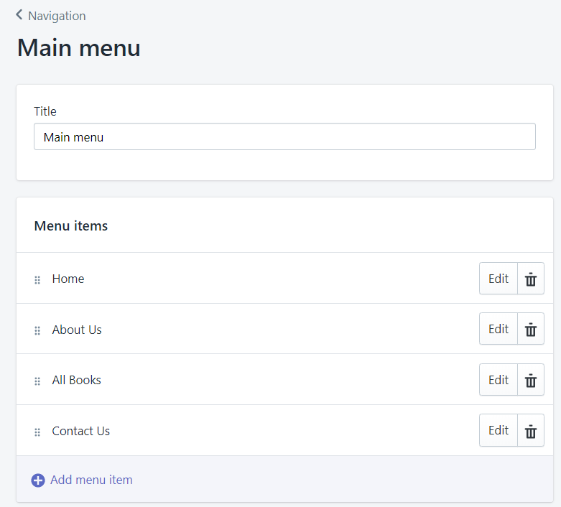
Theme for your Shopify Site 3 – Manage Menus, Links, and Pages (Understanding Navigation – Changing the order of the Menu items)
You can change the order of the menu item by just dragging the menu to any order you like.
Point the menu item and hold the left button of your mouse and drag it up, down or in the order you like.

Slide 45
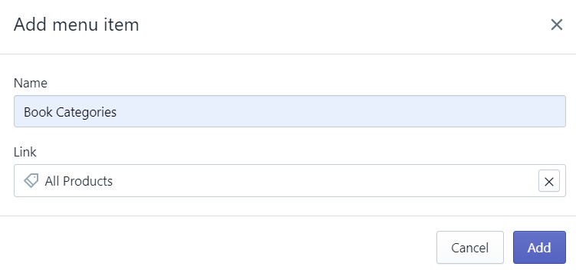
Theme for your Shopify Site 3 – Manage Menus, Links, and Pages (Understanding Navigation – Dropdown Menu)
You can build drop-down menus by creating or moving menu items so that they are "nested" below a top-level item.
The top-level item appears in the main menu on your online store, and the nested menu items appear in a drop-down menu.
The top-level item can have up to two levels of nested drop-down menus
In the example, we added book categories and this will include sub-categories like:
Programming, Analysis, Business & etc. but make sure this collection has been added and products are categorized according to the said collections

Slide 46
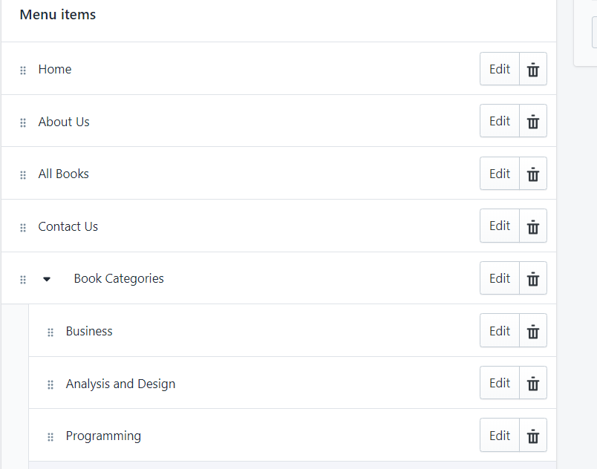
Theme for your Shopify Site 3 – Manage Menus, Links, and Pages (Understanding Navigation – Dropdown Menu)
In the example, we created three sub-categories on the Book Categories.
To do this you need drag the three sub-categories under the Book Categories to create a dropdown list
For more information on how to create a dropdown list in your Shopify site watch the video below:
https://youtu.be/ph2-a8Dbio4

Slide 47
Activity 8.5
Refer to your book for Activity 8.5

Slide 48
Theme Customization and Configurations
In this lesson, the applied theme customization, pages customization and other configurations can be viewed in the URL link below:
https://gcs-bookstore.myshopify.com/
Since this is a free trial plan, you need to enter the password to view the full Shopify site:
Password: gEnEtic_2020

Slide 49
Portfolio – Theme Customization and Configuration
The contents of your portfolio for this lesson are the following:
Selected Theme for the Shopify site
Pages customization (Home Page, Product Page, Collection Page, Cart & etc.)
Customized menus, links, and pages

